Slide 1
Building the Foundation for Innovation an Overview of the Digital Object Architecture
By Robert E. Kahn
Corporation for National Research Initiatives
Reston, Virginia USA
A presentation at The African Internet Governance Forum -AfIGF2016
Durban, South Africa
October 16, 2016

Slide 2
Outline of the Talk
Internet Objectives and Evolution
Protocols to enable connectivity between networks and computers
Social Structures to guide its evolution
Managing Digital Information in the Internet
The Digital Object Architecture
Near-term Applications
Preservation & long term access
Guiding the Infrastructure Evolution
The DONA Foundation
Empowering the technical community

Slide 3
Bindings to Technology vs. Information
Arpanet – 16 bit addresses → wires
Internet – 32 bit IP addresses → machines
Web - URLs → <IP Address/filename>
Digital Object Architecture
Describes a means of managing information over both short and long time frames
Digital Objects are the basic structures
includes a resolution component that resolves identifiers to “state information” about the desired information
such as access means, multiple locations, authentication, public keys, and terms and conditions for use.

Slide 4
Fundamental properties of the Digital Object Architecture
It is based on the same architectural ideas that are embedded in the Internet’s architecture and which have sustained its evolution, the two most important of which are:
Open Architecture (defined protocols & interfaces)
Independence from the underlying technology
Integrated in the Internet

Slide 5
General Characteristics of the Digital Object Architecture
Basic starting point is the concept of a “Digital Object” (DO) defined as a set of bits, or set of sequences of bits, having an associated unique persistent identifier; and one or more DOs may be integrated as a single operational entity.
Describes the management of DOs with an “open architecture approach,” and supports direct interaction with DOs using identifiers.

Slide 6
Components of the DOA
Identifier/resolution mechanism, known as the Handle System
DO Repositories store DOs and enable access by means of identifiers
DO Registries store metadata records about DOs and enable them to be found by searching.
Registries use Repositories; Repositories require registries.

Slide 7
CORDRA
An integration of the DO Repository and DO Registry components
Available for download from cordra.org in one of two modes:
Experimental mode to evaluate the technology where CNRI provides both the prefix to use for identification of DOs and also provides the handle resolution service
Regular mode where the party downloading the software must make separate arrangements to obtain a prefix and the handle resolution service

Slide 8
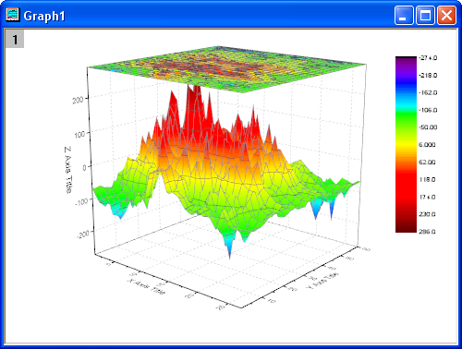
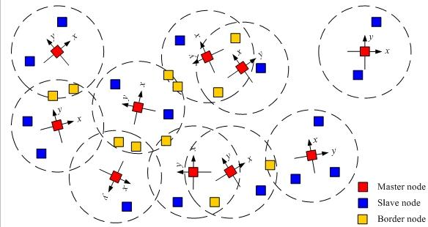
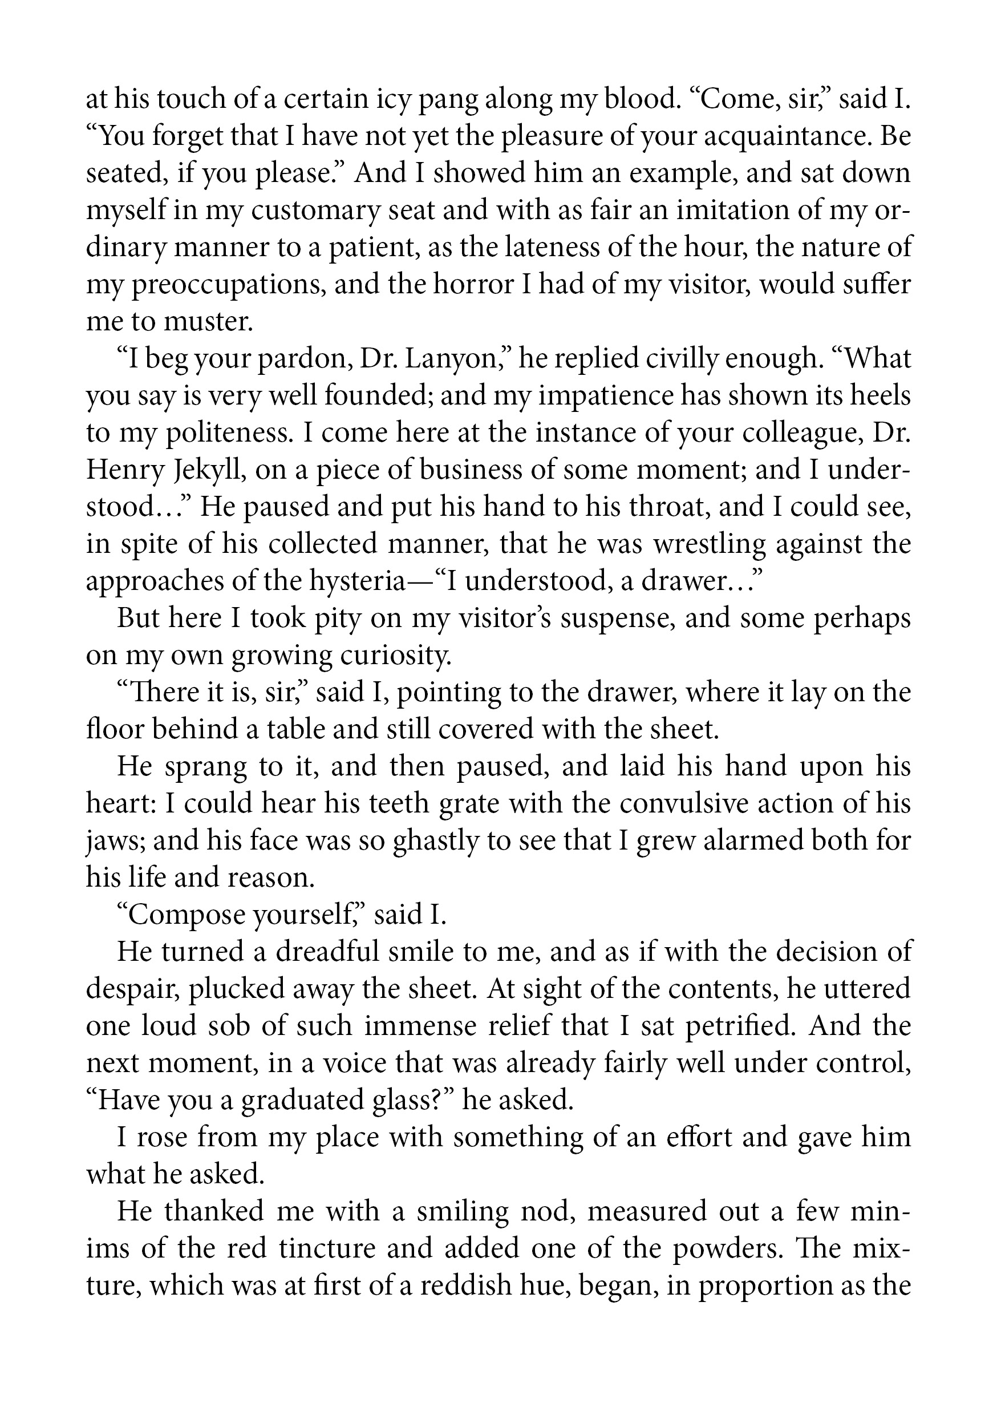
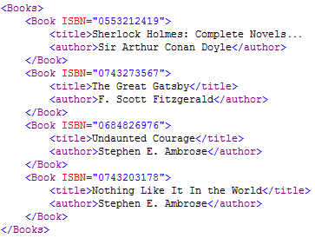
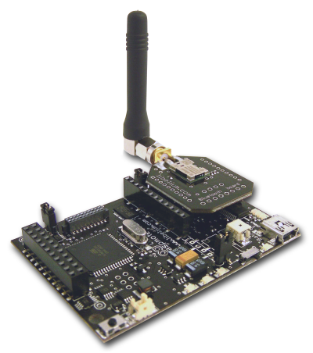
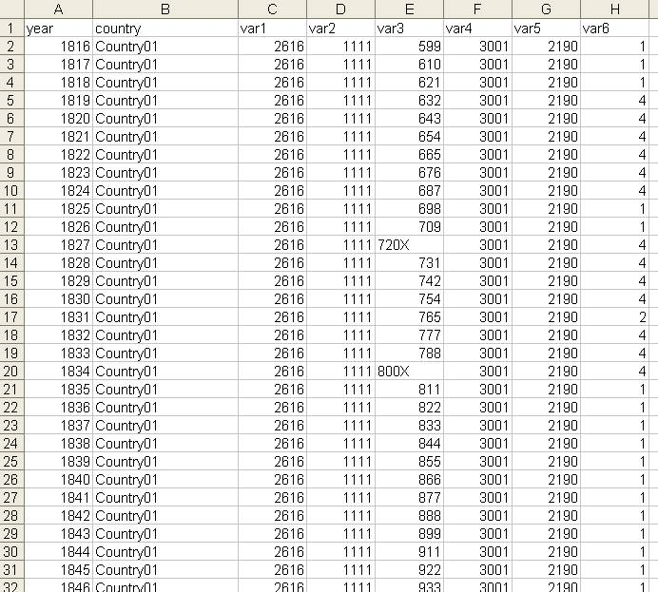
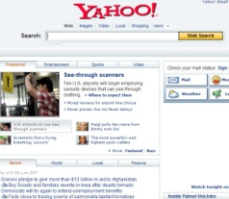
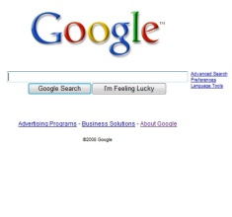
Digital Object Architecture: Information Management on Networks
Client
Repositories
Resource Discovery
Identifier Resolution Service
Search Engines, Metadata Databases, Catalogues, Registries, etc.

Slide 9
Manifesting the Information (by the user)
Proprietary data formats – need to preserve programs that can interpret the formats, and the environments for running those programs
Open data formats – need to preserve software interpreters for those formats and the environments for running them.
Information Structure Descriptions – need to maintain resolvable type information to recreate the original data structure so that it can be processed with current technology.

Slide 10
Framework for Discovery ITU-T Recommendation X.1255
Based largely on the Digital Object Architecture, ITU-T Recommendation X.1255: “Framework for discovery of identity management information” was approved in September 2013.
Focused specifically on discovery and access to information in digital form, X.1255 is applicable to operational requirements for information management more generally.
For purposes of X.1255, a digital object is defined as a digital entity; and the Recommendation describes a data model and interface protocol.

Slide 11
The Handle System ®
A basic identifier/resolution system for the Internet.
Resolves a digital object’s identifier to that object’s current state information
Identifier persists when location and other attributes of the object changes.
Logically a single system, but physically and organizationally distributed; it is highly scalable
Associates one or more typed values, e.g., IP address, public key, URL, metadata, to each identifier.
Secure resolution and administration using an integrated PKI capability as an option; optimized for speed and reliability.
Open, well-defined protocol and data model, IPR free.
Provides infrastructure for a wide range of application domains, e.g., digital libraries, network management, service discovery, and IoT.

Slide 12
Structure of the Handle System
System currently consists of a Global Handle Registry (GHR) and many distributed local handle services
Each service responsible for defined portion of the identifier space
The GHR is distributed and scalable; each local handle service can itself be distributed – and may be separately branded
Resolution returns a handle record containing type/value pairs
Typing is itself scalable; handles are used as type identifiers
No limit on number and length of type/value pairs
Each handle record may provide specification for processing the digital object
Supports distributed handle administration in the Internet
Handle System Protocol runs over UDP, TCP, or HTTP
System is compatible with IPv4 and IPv6

Slide 13
What is a Handle?
35.1234/12345678
Prefix
Suffix
Handles (or more generically “digital object identifiers”) are globally unique and resolvable
Prefixes are allotted to local handle service providers and most prefix handle records are currently stored in the Global Handle Registry (GHR).
A handle prefix is typically resolvable by the GHR to an IP address for a handle resolution service such as an organization providing local handle services.
The full handle is resolvable by the handle resolution service into set of typed values.
Character Set: Unicode 2.0
Encoding: UTF-8
Prefix: Currently allotting only numeric values.
Suffix: No restrictions.

Slide 14
Handles Resolve to Typed Data
Handle
Data Type
Handle Data
35.1525/b.2009.59.5.9
HS_ADMIN
handle=0.na/35.1525; index=200;
[delete hdl,add val,read val,modify val,del admin,add admin,list]
Data Types are also resolvable handles and can be specific to:
The Handle System (*)
HS_ADMIN
HS_PUBKEY
HS_SIGNATURE
URL etc…
An application or service
10320/loc
A group/community
A device type
Types should be identified with a handle and resolve to a type description.
(*) Handle System types
are registered as handles starting with the “0.TYPE/” prefix. (URL -> 0.TYPE/URL)
URL
http://www.caliber.net/abs/35.1525/2009.59.5.9
35.TYPE/DEVICE
35.1/1.2.3
<locations chooseby="locatt, country, weighted">
<location id="1" cr_type="MR-LIST" href="http://www.acme.org/iPage?doi=35.1525%2Fbio.20.5.9" weight="1" />
<location id="2" cr_src="unca" label="SECONDARY_BIOONE"
cr_type="MR-LIST" href="http://www.bioone.org/doi/full/35.1525/ bio.2009.59.5.9" weight="0" />
</locations>
10320/loc
Processing
Instructions go here!
HS_PUBKEY
0000000B4453415F5055425F4B4559000000000015009760508F15230B….
HS_SIGNATURE
eyJhbGciOiJSUzI1NiJ9.eyJkaWdlc3RzIjp7ImFsZyI6IlNIQS0yNTYiLCJkaWdlc….

Slide 15
Handle Resolution - Overview
MPA 22
MPA 21
Resolve 10.152/59.5
Resolve 0.NA/10.152
GSP 11
DONA
MPA 20
Handle System
Handle Service for 0.NA/10.152
MPA 10
MPA 86
Global
Handle
Registry
Handle Service
0.NA/35.1
Handle Service
0.NA/20.123.1
Resolve 10.152/59.5
Handle Service
0.NA/10.152
Handle Service
0.NA/86.1
Handle Service 0.NA/10.152
Handle Service
0.NA/35.1
Handle Service
0.NA/86.1
Authoritative
Service
Authoritative
Service
Mirror
Service 1
…...
Mirror
Service n
Authoritative
Service
SVR
#1
SVR
#2
SVR
#1
SVR
#2
SVR
#1
SVR
#1
`
Authoritative Service for 0.NA/10.152
SVR
#1
SVR
#2
SVR
#3
SVR
#4
SVR
#n
...
10.1525/59.5
URL
4
http://www.acme.com/
HS_SIG
20
eyJhbGciOiJSUzI1NiJ9…..

Slide 16
What is Metadata
People commonly define metadata as “data about data”
A more complete definition:
Metadata is a set of (structured) assertions about an entity/resource
Multiple parties may make those assertions
Veracity of those assertions is usually outside the scope of metadata
Those assertions could be about
Identity
what is the resource called?
Provenance
who created the resource?
Access
who views and admins the resource?
Assertions
Description
what is the resource about?
How to interpret it?
Technical
in what stage is the lifecycle?
Structure &
Representation
how is the resource formatted and encoded?

Slide 17
Digital Object Interface Protocol
Allows access to the entire object, or parts of it (each DO consists of multiple elements)
Some elements may be DOs by themselves or contain identifiers for other DOs
Enables global interoperability of repositories with security
Assumes that state information about resources, users, and organizations are represented as digital objects and may be referenced by their unique persistent identifiers

Slide 18
DO Interface Protocol
DO
Attributes
DO
DOIP
Elements
Attributes
DO
Logical
External
Interface
Elements
Attributes
DO
Digital Object
Interface Protocol
Elements
Attributes
DO
Elements
Attributes
Elements
…
DO Repository
Certain DOs contain desired data or information
Other DOs contain metadata

Slide 19
Who is responsible for operating the GHR?
The original GHR was operated by CNRI in Reston, VA in the US since the mid to late 1990s.
Until recently, CNRI had the sole credential and authorization to create all new prefixes.
CNRI decided to further enhance and develop the GHR architecture to enable multiple organizations to coordinate and administer the GHR on a multi-primary basis under the overall administration of the DONA Foundation.
The current GHR maintains backwards compatibility with all legacy handle prefixes.

Slide 20
DONA Foundation
Non-profit organization established January 2014 in Geneva, Switzerland
Currently 9 members of the Board of Directors
Provides overall administration of the Global Handle Registry (GHR), will support relevant standards and outreach activities, including pilot projects, to increase awareness of the DOA
Currently, five organizations have signed MPA Service Agreements; and two others have been designated as MPAs.
Approximately 12 MPAs are anticipated by 2018.

Slide 21
Administration of the GHR
Credentialing
Signing Credentials
Overall Administration
DONA Foundation
Non-profit organization
in Geneva, Switzerland
Multi-Primary
Administrator
Multi-Primary
Administrator
Multi-Primary
Administrator
MPA
MPA
MPA
MPA
MPA
Each MPA operates independently of the others; and each mirrors the
others’ one-delimiter prefix handle records up to an initial limit.

Slide 22
Concluding Remarks
For real-time communications, information as to how best to process a digital object is useful
Context may be needed to support interoperability across heterogeneous information systems
System interoperability is critical, and also requires security for more wide-spread application
Some level of abstraction is necessary for long-lived systems, since the underlying technologies will surely change over time
The Digital Object Architecture is an effective choice to satisfy these objectives

